Slide 1
Expanding your web presence
Lecture 7 (chapter 10)

Slide 2
Staying ahead of online marketing wave- Expanding your web presence
A)Marketing Your Online Business Offline
You have to market your domain name as much as you market your business, Ask your designer to provide a style guide, including capitalization and spacing, for your logo and logotype in various formats(colour). For example, decide whether your domain name should appear as YourDomain.com, Yourdomain.com, yourdomain.com
1)- Stamping your URL on everything (It goes without saying that your domain name appears on your letterhead and business cards, just as it does on your signature block for e-mail. Whenever you reprint other stationery items, include your URL on(shipping labels,reciepts). Make sure that every item includes your URL — from catalogs, product literature
2)Giving away swag, bling, and freebies-including your URL on pens, pencils, T-shirts, hats, mouse pads, mirrors, mints, magnets, mugs, and more (ex epromos.com –sample companies selling promotional items.
3) Getting out your name at offline community events (have a local office, Need to build credibility with local press, Seminars or training sessions|)
4)Including your Web address in offline advertising -There is no added cost for including your URL in any offline advertising radio, TV, print, or billboard. . If you have multiple offline advertising activities, ask your developer to create a simple extension for your URL. Redirect that URL to the page with the item you’re promoting, like Dell computer does for its TV ads at www. dell.com/tv

Slide 3
Going Live: Coordinating a Site Launch
The term go live applies to making your site visible online to the world, moving it from a development location to one that is publicly accessible.
Launches are often tied to external events, such as a trade show, announcement of funding, or the start of a shopping season(Promotions for the first visitors, Press releases and online/offline conferences, Announcements on calendars and event sites, Announcement tag lines in your e-mail signature block, Online and/or offline advertising.)
Launch refers to a media event that draws online and offline publicity to your site. A launch effort makes sense in the following scenarios:
✓ You’re opening a completely new business.
✓ You have an existing brick-and-mortar business with significant name
recognition.
✓ You have stakeholders or investors who need or expect public recognition for the opening of the new or redesigned site.
✓ You have an innovative application or use new technology on a start-up or redesigned site.

Slide 4
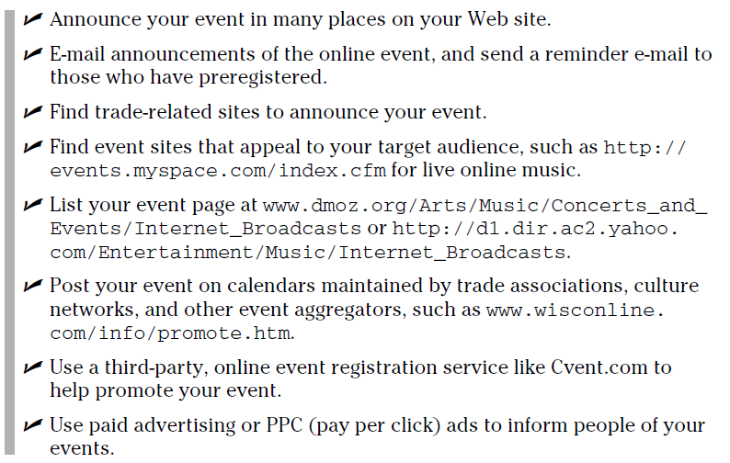
3)Producing Online Events

Slide 5
Marketing Internationally Online
Analyze costs carefully when setting prices for international shipment
Consider the need to handle
✓ Customer and technical support in many time zones and languages
✓ Packaging and instructions in multiple languages
✓ Payments in different currencies
Promoting your site internationally
Indicate which countries you serve by using a map, drop-down list, flags, graphics, or other languages.
Submit your site to country- and language-specific search engines ex-www.ananzi.co.za for south africa and http://asian-links.com/cgi/odp/index.cgi for Asia
Translate your home page into the target language of the country you want to serve. Remember, there’s a difference between British and American English.
Completely translate your site into the target language(s) and customize it for local needs, adding local contacts.

Slide 6
Generating Leads with an Affiliate Program
An affiliate program is an online referral system that offers a commission to the source of the lead.
When prospective customers click through on a link or close a sale, the originating site receives a payment. While often used by product companies, affiliate programs can be equally valuable for cross referrals among service providers. They can be a wonderful source of leads.ex-https://affiliate-program.amazon.com/
Example ArtfulHome.com uses affliates to generate leads

Slide 7
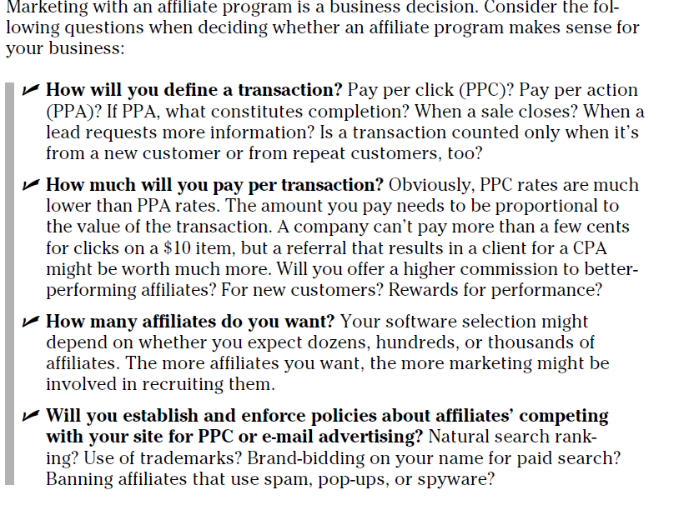

Slide 8

RSS (Real Simple Syndication)

Slide 9
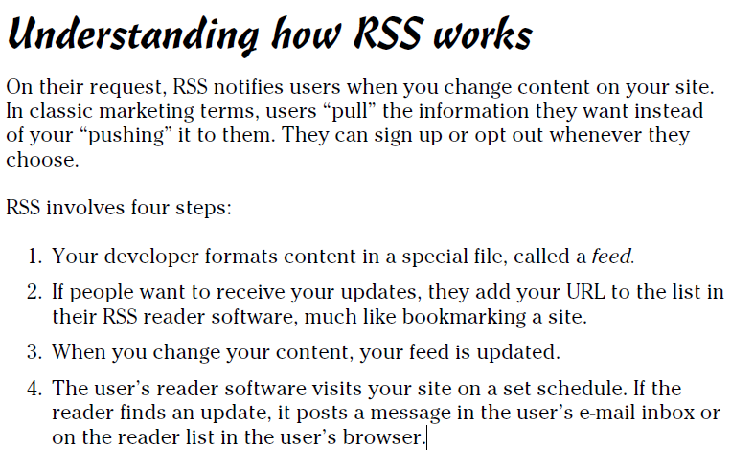

Slide 10
Finding Fans with Real Simple Syndication (RSS)
Real Simple Syndication (RSS), indicates that visitors can sign up to receive automatic notifications of new content on that page.
RSS works best for sites with frequently changing content, such as news, weather, science, medicine, or technical support updates. It’s also useful for product sites with large, dynamic inventories, such as event tickets or airline flights.
RSS is an excellent way to let people know immediately when you post new products, sales, or specials. Because people might be more likely to sign up for a feed.ex www.feedburner.com Prepares blogs and other content feeds for RSS

